Slide 1
Hybrid Modeling of RF and FSO Signal Attenuation Under Different Weather Conditions
A Data-Driven Approach to Design Weather Related Signal Forecasting
Aditya Venugopalan Nediyirippil
a1899824

Slide 2
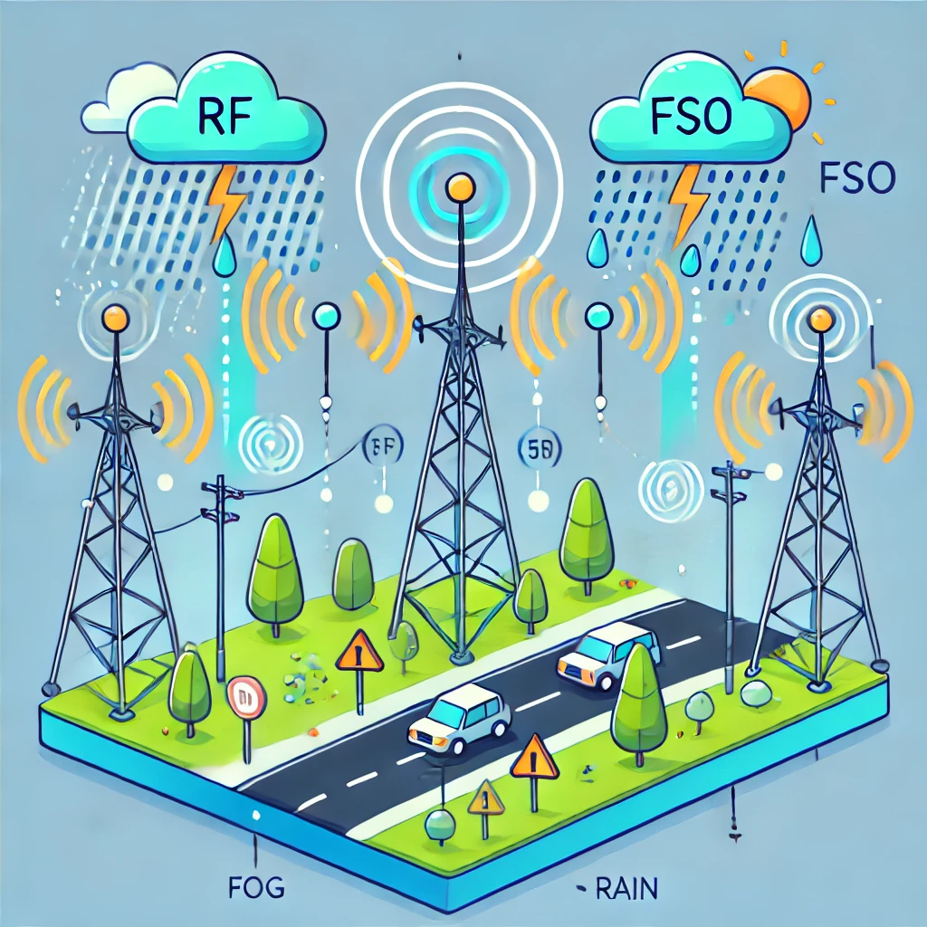
Background
What is RF & FSO Communication?
RF (Radio Frequency): Reliable in bad weather but slower speeds.
FSO (Free-Space Optics): Faster but affected by fog, rain, & dust.
Hybrid RF-FSO: Switches between RF & FSO for better stability.
Why Does Weather Affect Signals?
Fog & Rain: Absorbs or scatters FSO signals, causing loss.
Turbulence: Distorts FSO signals → errors in transmission.
Heavy Rain: Weakens RF signals as water absorbs radio waves.
Why is This Important?
Telecom: Used in 5G & internet providers.
Defense: Key for satellites, drones & military networks.
Smart Cities: Helps in AI & IoT services

Slide 3
Project Aim & Objectives
🔹 Aim To develop accurate, data-driven models that predict signal attenuation in hybrid RF–FSO communication systems under varying weather conditions.
🔹 Objectives • Analyze environmental factors that affect RF and FSO signals • Build and compare general vs. per-SYNOP models • Apply feature selection and model optimization to improve performance • Evaluate whether hybrid modeling using predicted RFL helps in FSO prediction

Slide 4
RF & FSO Signal Attenuation And Why it is a challenge ?
RF & FSO signals weaken under different weather conditions.
FSO fails in fog due to light scattering, while RF struggles in rain due to water absorption.
A reliable communication system needs a hybrid approach that adapts dynamically.
Why is This a Problem?
Data loss & interruptions impact telecom, defense, and smart infrastructure.
Current models fail to predict signal loss accurately under dynamic weather.
A data-driven approach is needed to improve reliability.

Slide 5
Understanding the Dataset: Features & Structure
The dataset contains 27- environmental features (e.g., temperature, humidity, wind speed, visibility) that describe weather conditions.
1 categorical feature, SYNOP Code, represents different weather types like clear, foggy, or rainy conditions.
Two target variables:
RFL_Att (RF attenuation)
FSO_Att (FSO attenuation)
The goal is to analyze how weather affects signal loss and improve predictions using machine learning.

Slide 6
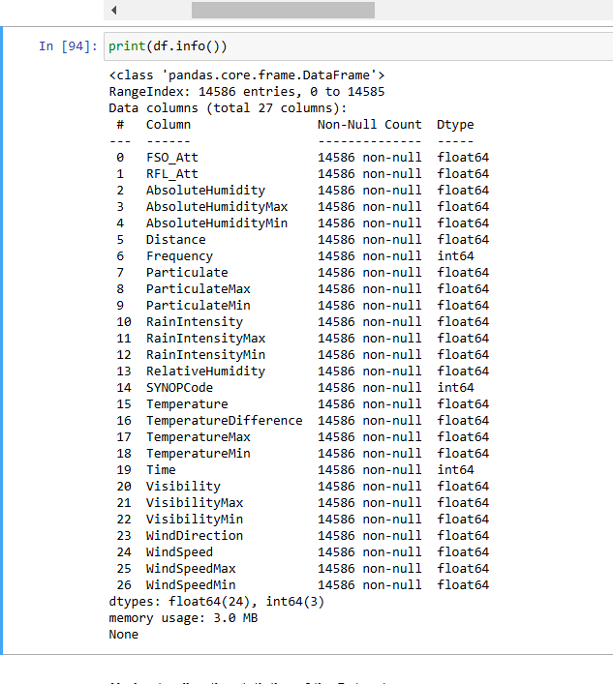
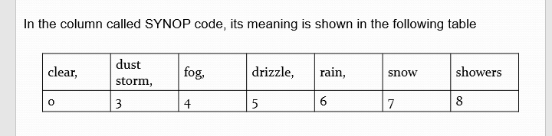
Exploring The Dataset
Our dataset includes:
Weather Features: Temperature, humidity, wind, visibility, and pressure, recorded at different levels (min/max/avg).
SYNOP Code: A numerical label representing weather types (Clear, Rain, Fog, Snow, etc.).
Signal Attenuation: Measures how much RF and FSO signals weaken under different weather conditions.
This dataset allows us to analyze how weather affects communication signals and develop predictive models.

Slide 7
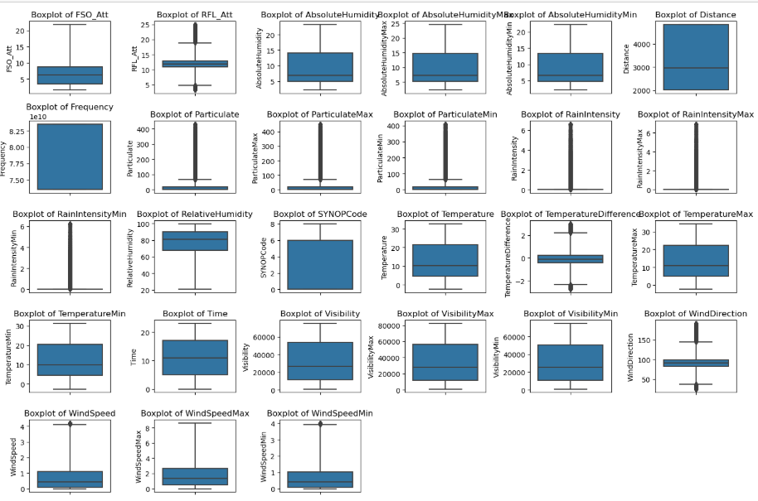
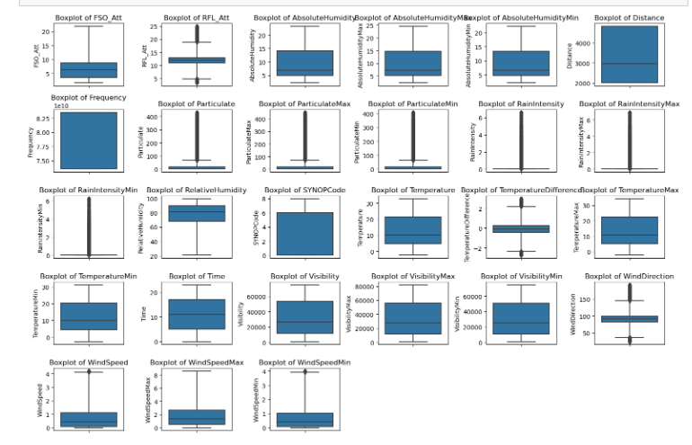
Removal Of Outliers
Before
After

Slide 8
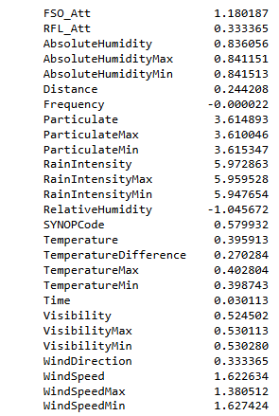
Correcting The Skewness
As we can see from the above information related to skewness, we can Particulate, ParticulateMax, ParticulateMin, RainIntensity, RainIntensityMax, RainIntensityMin, WindSpeedMax, and WindSpeedMin have high skewness . These features indicate that most of their respective values are clustered on left hand side applying a transformation will help to normalize the distribution and hence improving the model performance . On the other hand feature RelativeHumidity show negative skewness . Since we haven't done feature selection related process , we will include this feature and hence transform RelativeHumidity feature as well.

Slide 9
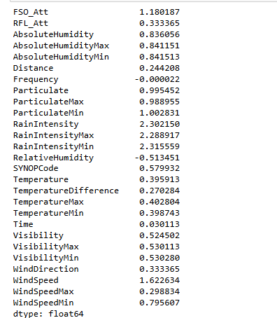
Correcting The Skewness
Applying the Square Root Transformation
Applying the Power Transformation

Slide 10
Data Splitting For Model Training
To build accurate predictive models, we split our dataset into training and testing sets. This ensures our model learns from one part of the data and is evaluated on unseen data for fair performance measurement.
Train-Test Split: We divide our dataset into 80% training and 20% testing to develop and evaluate our models.
Why Splitting Matters?
Prevents overfitting (where the model memorizes data instead of learning patterns).
Ensures fair evaluation of model performance.
Helps check if our dataset is balanced across different weather conditions.
Training Set: Used to fit the model. Testing Set: Used to check model accuracy.
Next, we will discuss how General Models and Per-SYNOP Models were built.

Slide 11
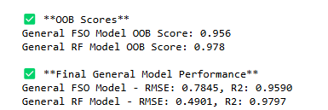
Building General Models RFL and FSO
We removed the target variables (FSO_Att , RFL_Att) and used all environmental features
Data was split into 80% training and 20 % testing to evaluate model performance
We used Random Forest Regressors with 100 estimators and enabled Out-of-Bag (OOB) score.
Performance Evaluation: We measured: RMSE (Root Mean Squared Error) – Lower values indicate better accuracy.
R² Score – Closer to 1 indicates better model fit.
OOB Score – Measures model’s ability to generalize.

Slide 12
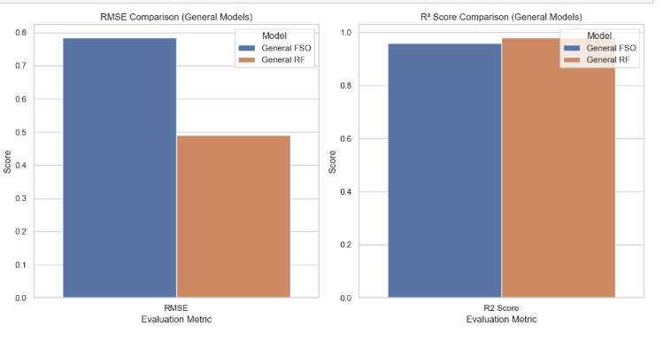
General Model Comparison
FSO vs RF: FSO Model has higher RMSE, meaning it struggles more to predict attenuation accurately.
RF Model has a lower RMSE, making it more precise.
R2 Scores are high for both models , which means they explain most of the variance of the signal attenuation
Overall: RF performs slightly better than FSO.
FSO predictions have more uncertainty, likely due to high weather impact

Slide 13
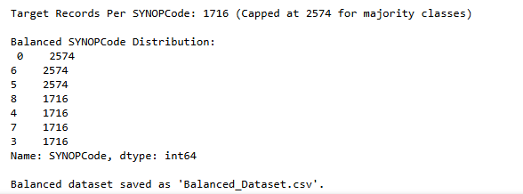
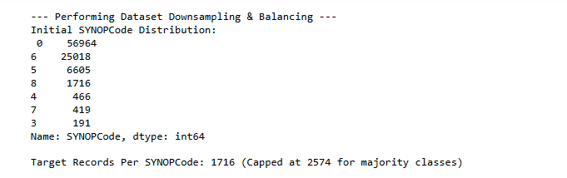
Down Sampling The Dataset
Before
After

Slide 14
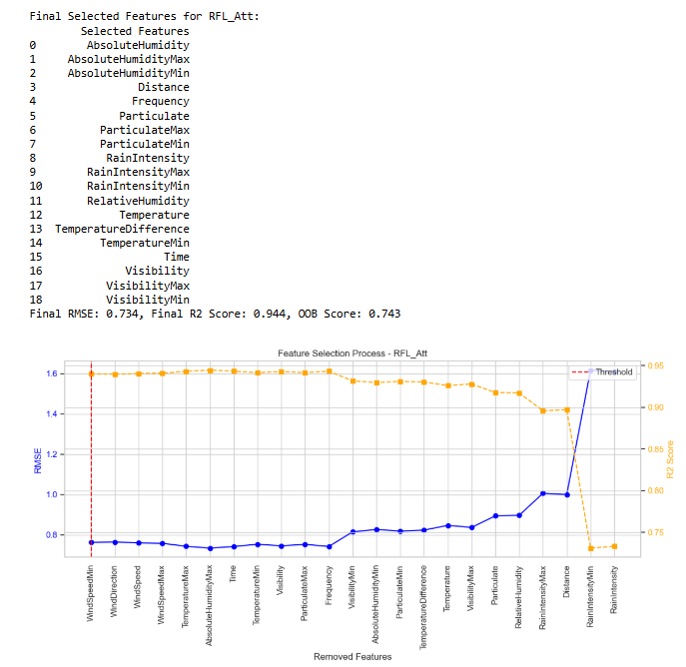
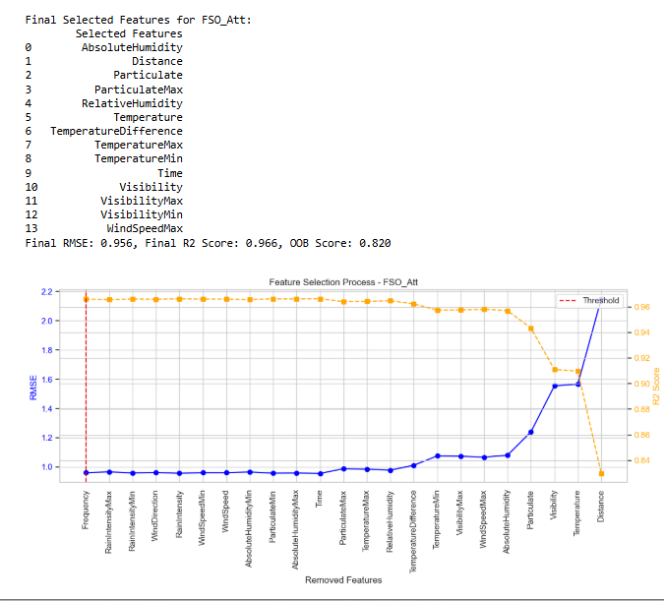
Feature selection
We removed less important features using Backward Feature Elimination (BFE). Each step, the least important feature (based on feature importance) was removed.
Final selection ensures models are simpler without sacrificing accuracy.

Slide 15
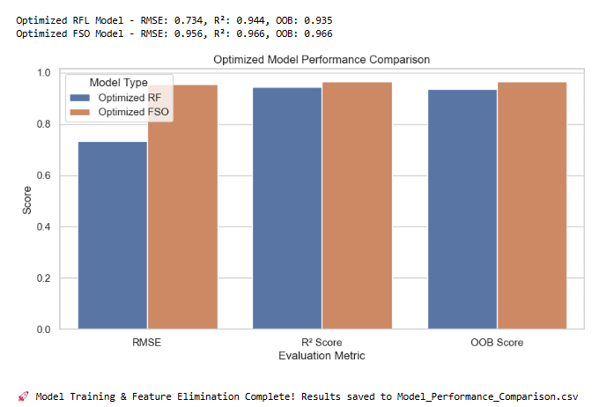
Optimized Model Performance
Optimized RF Model: Lower RMSE (0.734) → More accurate predictions.
High R² (0.944) → Strong correlation between input and output.
OOB Score (0.935) → Generalizes well.
Optimized FSO Model:
Higher RMSE (0.956) → More signal variation in FSO.
Better R² (0.966) → Captures patterns well.
OOB Score (0.966) → Strong overall performance.

Slide 16
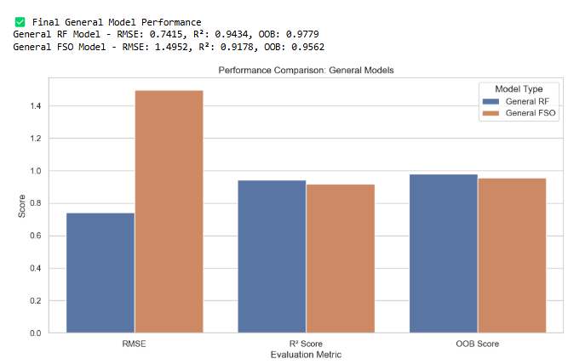
General Model Performance Evaluation
RF Model performed better than the FSO Model with lower RMSE and higher R².
FSO Model had higher RMSE, meaning more variation in predictions.
Both models had strong OOB scores, meaning they generalize well.
Conclusion: RF model gives more stable predictions, but FSO still captures key variations.

Slide 17
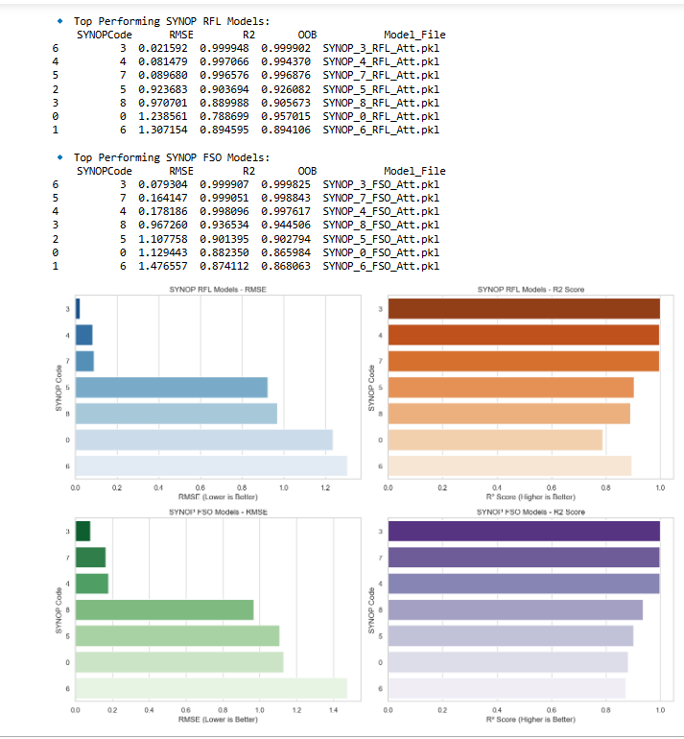
Per-SYNOP Model Training & Performance Analysis
We trained individual models for each SYNOP code instead of a single general model. Different weather conditions impact signals differently—custom models perform better. Key Findings:
Some SYNOP models had very low RMSE (better accuracy).
R² scores are near 1 for some models, meaning excellent predictions.
OOB Scores confirm the models generalize well.

Slide 18
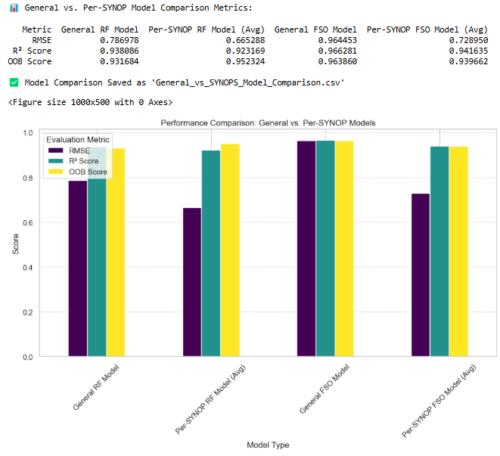
Comparing General vs. Per-SYNOP Models
Why Compare?
General models are trained on all weather conditions.
Per-SYNOP models are trained separately for each weather condition.
This helps understand if specialized models improve accuracy.
Key Observations:
Per-SYNOP RF models have lower RMSE → More accurate predictions.
Per-SYNOP models show better OOB scores → Generalize better than general models.
FSO models generally have higher RMSE than RF models, indicating more sensitivity to weather conditions.

Slide 19
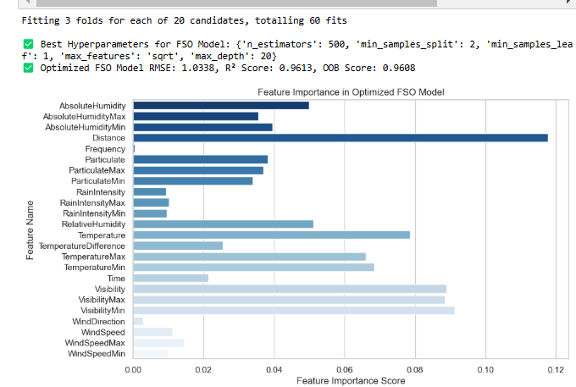
Hyperparameter Tuning for FSO Model
Why Hyperparameter Tuning?
Helps find the best settings for the Random Forest model.
Improves accuracy by optimizing parameters like tree depth and feature selection.
What Happened?
Used Randomized Search CV to test different hyperparameters.
Best parameters found: 500 trees, max depth of 20, and sqrt for feature selection.
New model trained using these settings.
Results:
RMSE improved to 1.0338 (better accuracy).
R² score = 0.9613 (strong predictive power).
OOB score = 0.9608 (model generalizes well).

Slide 20
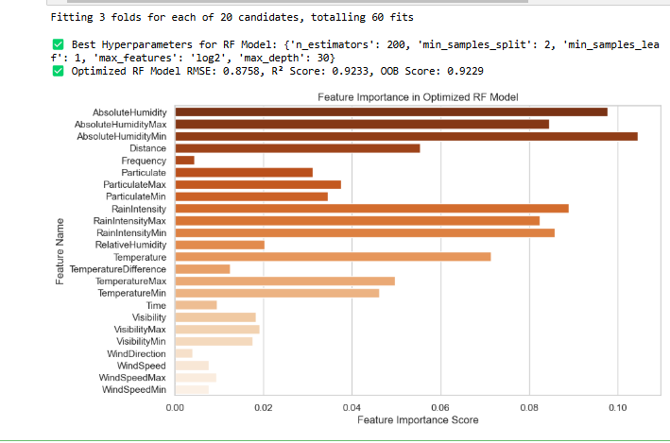
Hyperparameter Tuning for RF Model
Why Hyperparameter Tuning?
Optimizing the Random Forest model for better accuracy.
Adjusts tree depth, number of estimators, and feature selection.
What Happened?
Randomized Search CV tested 20 different hyperparameter combinations.
Best configuration found: 200 trees, log2 features, max depth 30.
The model was retrained using these settings.
Results:
RMSE improved to 0.8758 (better accuracy).
R² score = 0.9233 (high predictive strength).
OOB score = 0.9229 (strong generalization).

Slide 21
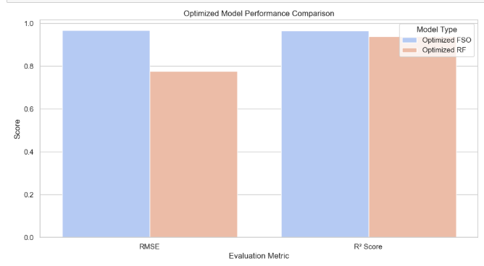
Comparison of Optimized RF & FSO Models
What is Happening?
We compare the optimized RF and FSO models using two key metrics:
RMSE (Lower is Better)
R² Score (Higher is Better)
Visualization helps us assess model accuracy after tuning.
Key Observations:
RF Model has lower RMSE, meaning better predictive accuracy.
FSO Model has slightly better R² score, showing strong correlation with the target variable.
Both models perform well after hyperparameter tuning, showing balanced improvement.

Slide 22
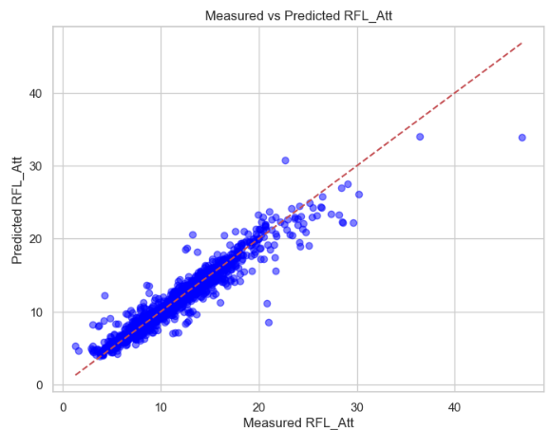
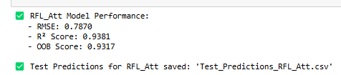
Evaluating Predictions – Measured vs. Predicted RFL Attenuation
Trained RF model to predict RFL_Att using environmental features.
Model Performance:
RMSE: 0.7870 (Lower is better)
R² Score: 0.9381 (Higher is better)
OOB Score: 0.9317 (Model stability)
Closer points to red line → Better accuracy.
Compares actual vs. predicted values.
Most predictions align well, confirming a strong model fit.

Slide 23

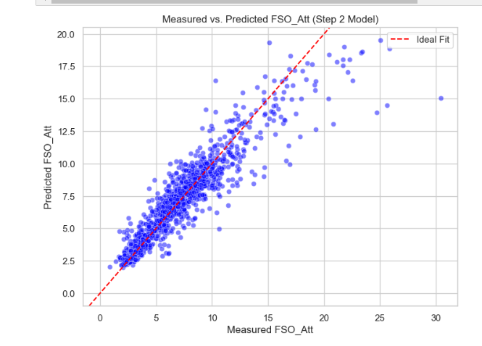
Evaluating Step 2 FSO Model (With Predicted Radio Frequency Attenuation)
We used Predicted RFL_Att as an additional feature to improve FSO_Att predictions.
A Random Forest Model was trained and tested with this new feature.
Model performance:
RMSE: 1.4438 (higher than the general model)
R² Score: 0.8670 (lower than the general model)
OOB Score: 0.8662
Result: Using Predicted RFL_Att did not improve the prediction of FSO_Att. Further hyperparameter tuning or feature engineering is required.

Slide 24
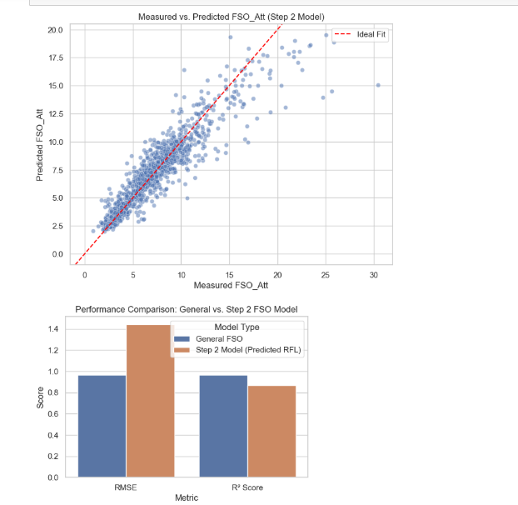

Correlation Analysis – RF vs. FSO Attenuation
We tested if using the Predicted RFL_Att as an additional feature could improve FSO_Att predictions.
Performance worsened, with higher RMSE and lower R² compared to the general FSO model.
Pearson Correlation between RFL_Att and FSO_Att is -0.0042 (almost no linear relationship).
Mutual Information Score is 2.4004, suggesting weak nonlinear dependence.

Slide 25
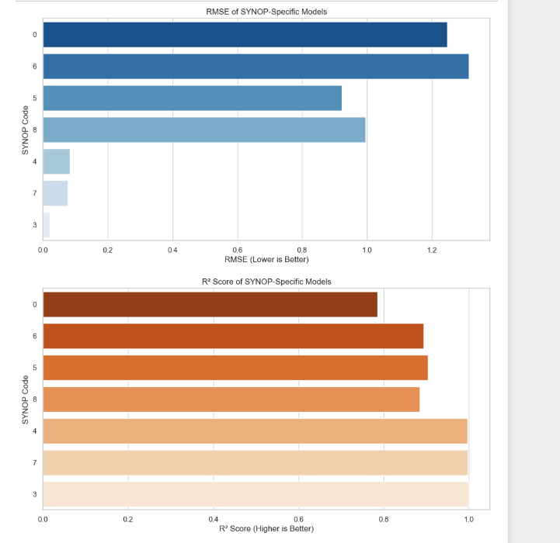
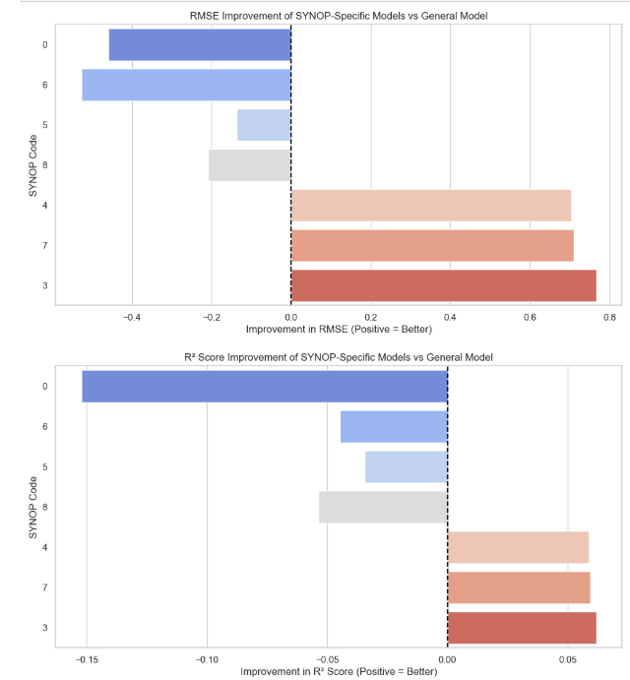
SYNOP-Specific Model Performance Analysis

Slide 26
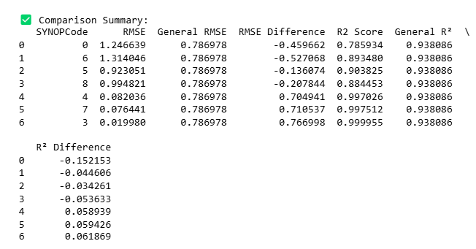
SYNOP-Specific Model Performance Analysis
Key Points
Trained Random Forest models for each SYNOP code using backward feature elimination.
Compared performance of SYNOP-specific models against the general RF model.
Metrics Evaluated: RMSE (lower is better) and R² Score (higher is better).
Results
SYNOP models generally improved RMSE over the general model (some cases significantly).
R² scores showed mixed results, indicating potential overfitting or insufficient data for some SYNOPs.
Comparison with General Model:
Some SYNOPs performed significantly better than the general model.
Others had little to no improvement, likely due to data limitations.

Slide 27
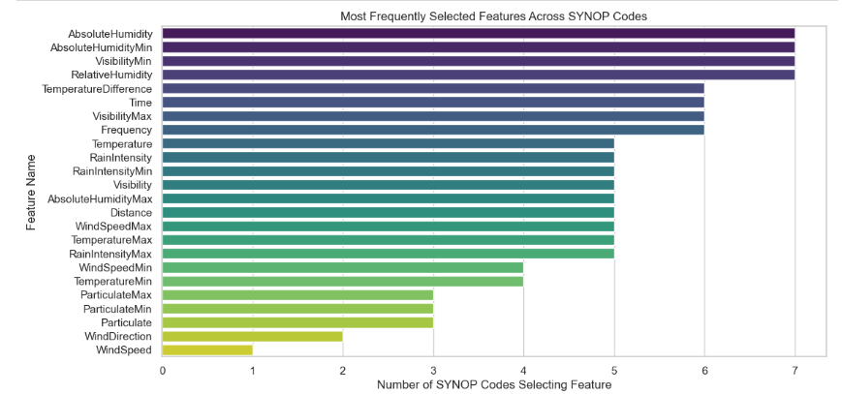
Feature Selection Frequency Across SYNOP Codes
Analyzed which features were most frequently selected across all SYNOP-specific models.
Counted occurrences of each feature across all SYNOP codes.
Top selected features include:
Absolute Humidity (most frequently used).
Visibility, Temperature, and Rain Intensity were also common.
Wind-related features were least selected.
Visuals to Include
Bar Chart: Feature selection frequency across SYNOP codes.
Conclusion
Some features are universally important across SYNOP models.
SYNOP-specific variations exist, meaning different locations prioritize different weather conditions.
Insights can help in feature engineering for future models.

Slide 28
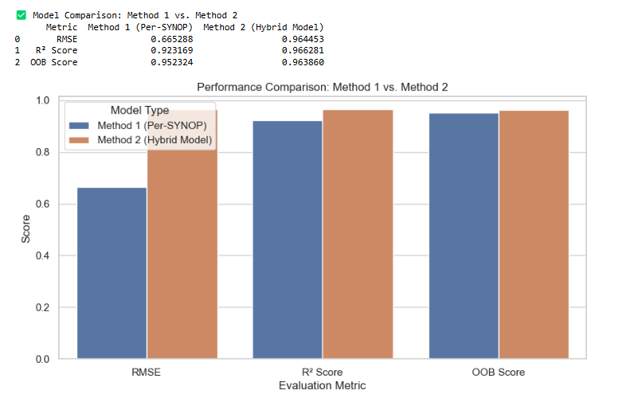
Comparison of Method 1 (Per-SYNOP) vs. Method 2 (Hybrid Model)
Method 1 (Per-SYNOP models): Trains a separate model for each SYNOP code.
Lower RMSE (better accuracy) but requires more models.
Method 2 (Hybrid model): Uses a single model leveraging predicted RFL_Att.
Higher RMSE but simpler implementation.
Higher R² score, indicating better generalization.

Slide 29
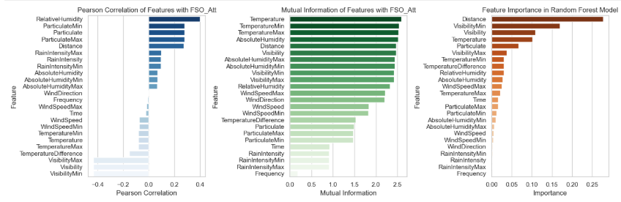
Slide Title: Feature Interpretability & Selection for FSO Attenuation
Feature Evaluation Methods:
Pearson Correlation: Measures linear relationship with FSO_Att.
Mutual Information: Captures non-linear dependencies.
Random Forest Importance: Determines impact on model prediction.
Findings:
Distance, Visibility, and Temperature were top-ranked across all three methods.
Pearson correlation results showed weak direct relationships.
Mutual information was higher, suggesting non-linear dependencies.
Random Forest identified Distance as the most important predictor.

Slide 30
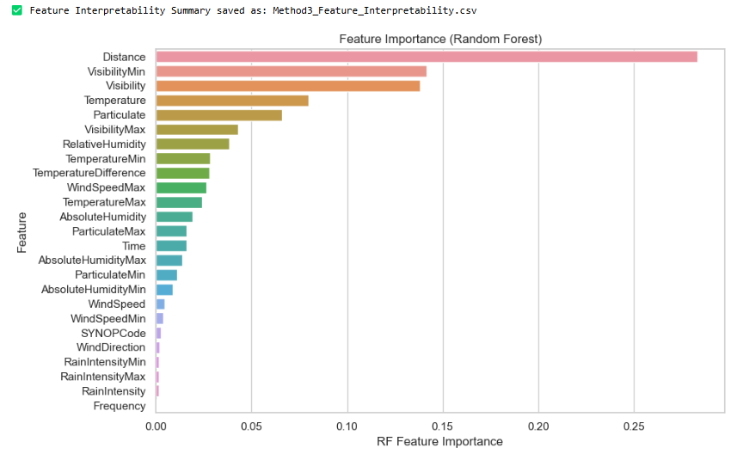
Feature Interpretability & Selection for FSO Attenuation
Distance is the most influential factor in predicting FSO attenuation, significantly higher than other features.
Visibility (Min & Avg) and Temperature are also key predictors, indicating their strong influence on FSO signal loss.
Particulate matter and humidity-related features contribute moderately.
Wind-related and SYNOPCode features have lower impact, suggesting they are less useful for prediction.
Implications
Top-ranked features (Distance, Visibility, Temperature) should be prioritized in modeling.
Low-importance features can potentially be removed to simplify the model without losing performance.

Slide 31
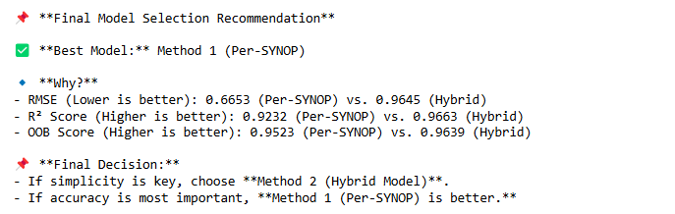
Conclusion
Key Takeaways from the Hybrid RF-FSO Modeling
Feature Selection Matters: Environmental factors like distance, visibility, and humidity play a key role in attenuation. Independent vs. Hybrid Models: Per-SYNOP (Independent) models performed better for RF attenuation, while joint modeling was less effective for FSO. Performance Comparison: Per-SYNOP models achieved lower RMSE and higher R² scores compared to general models. Step 2 Hybrid Model Findings: Using Predicted RFL_Att to enhance FSO_Att prediction did not improve performance, requiring further tuning. Final Model Choice: Per-SYNOP models (Method 1) are the best-performing approach for accurate attenuation modeling.

Slide 32
Future Work
Improve Model Accuracy – Further optimize hyperparameters and refine feature selection.
🔹 Explore Advanced Models – Test deep learning and ensemble methods for better predictions.
🔹 Real-World Testing – Validate models with live weather data for practical deployment.
🔹 Integration with Networks – Apply models to 5G/6G and satellite communication systems.

